Slide 1
Standard slides for Business Central analytics sessions
Copy-paste-edit at your own will

Slide 2
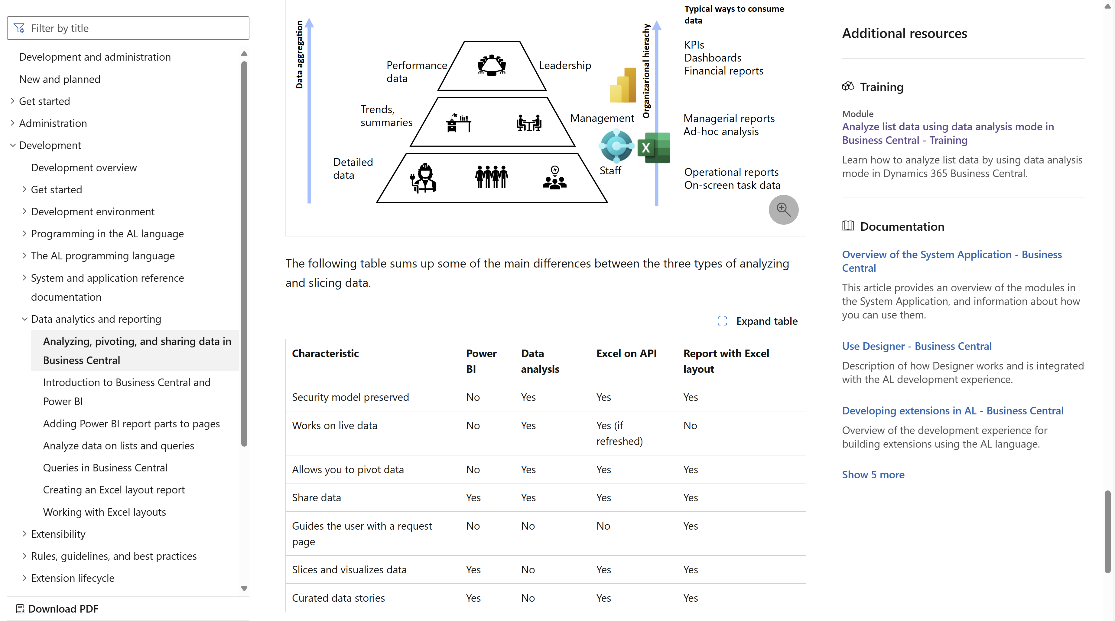
Developer docs https://aka.ms/bcDeveloper
Notes:
This is the developer docs that explains the BI triangle., how tools map to user needs, and different characteristics of the tools.

Slide 3





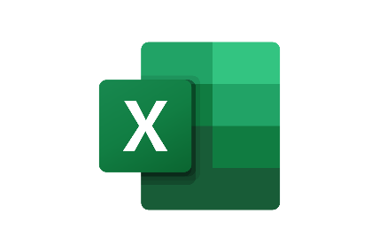



Typical analytics needs in organizations
Typical ways to consume data
KPIs
Dashboards
Financial reports
Data aggregation
Performance data
Leadership
Trends, summaries
Organizarional hierachy
Management
Managerial reports
Ad-hoc analysis
Detailed
data
Staff
Operational reports
On-screen task data
Notes:
This slice shows where Power BI, Data Analysis, and Excel fit into the analytics story

Slide 4
The world is changing (in reporting)
If customer asks, “Can you build me a report?”
STOP asking “Sure. How should it be formatted?”
INSTEAD ask “What do you need to analyze and for what?”
THEN choose the tool of choice
Power BI (and embed), or
Query/List page with Data Analysis, or
AL report with Excel layout
Notes:
You might end a session for developers with this (recapping the BI triangle)

Slide 5
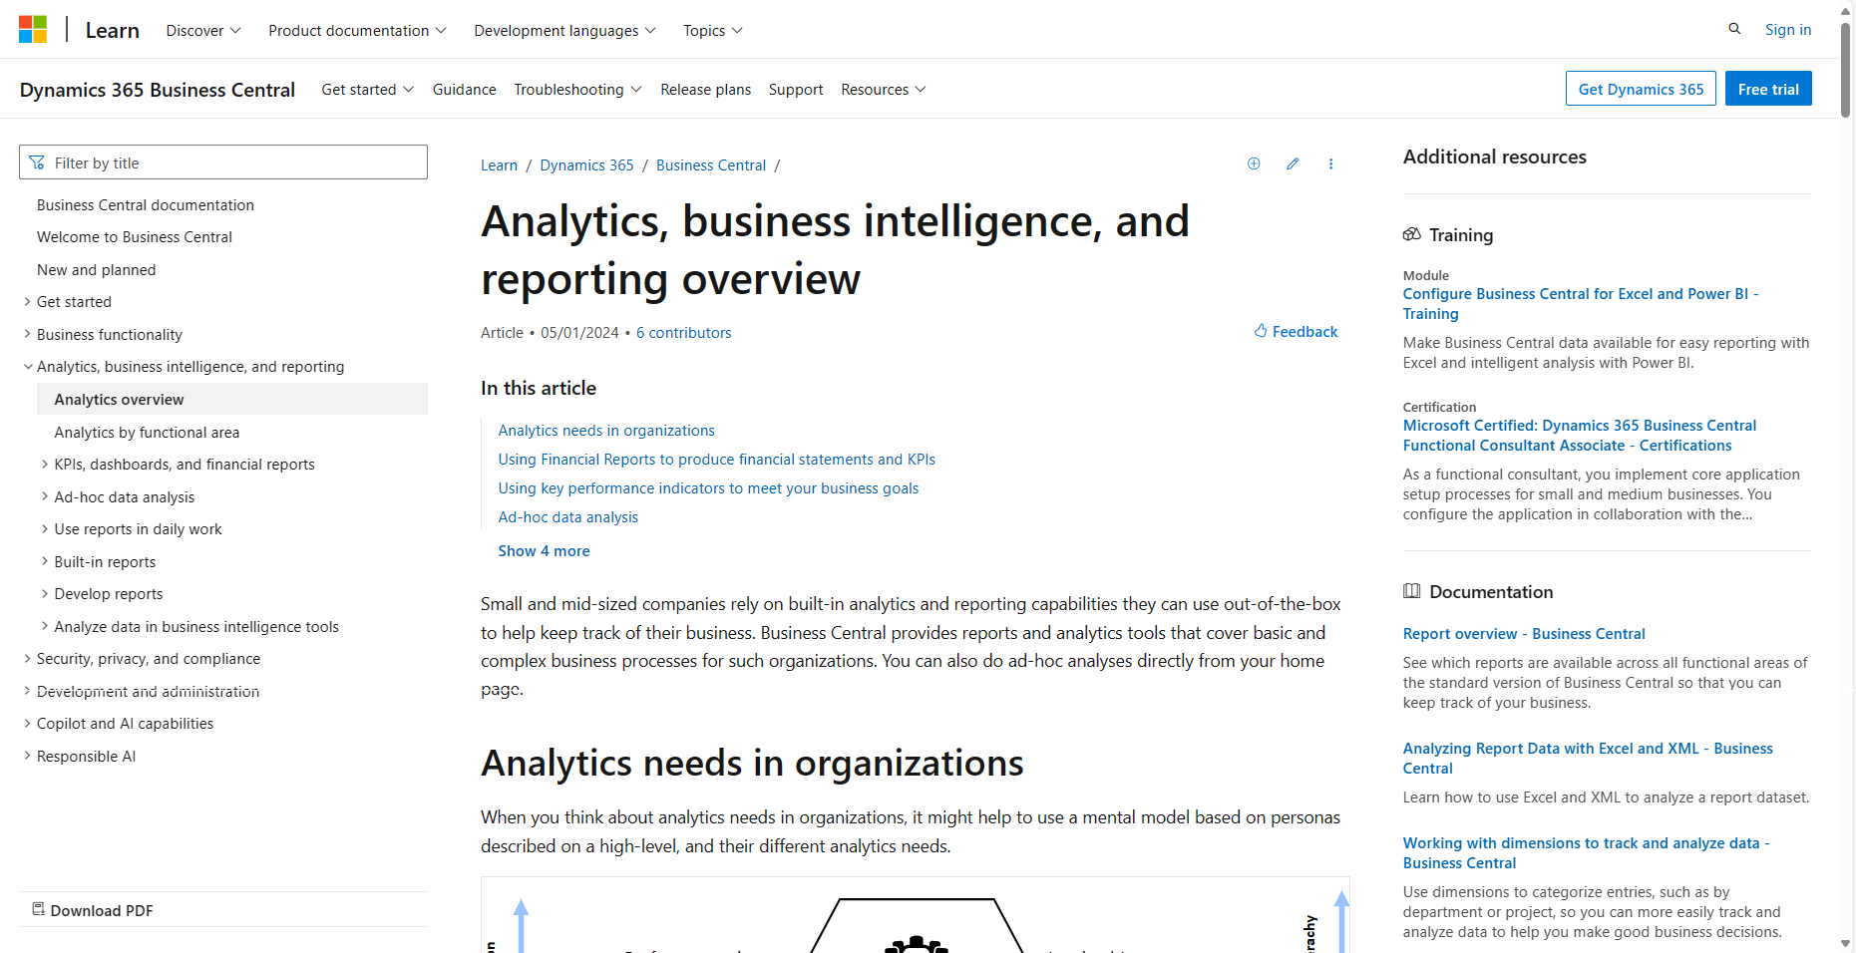
aka.ms/bcReporting
Notes:
This is the general analytics story end-to-end

Slide 6
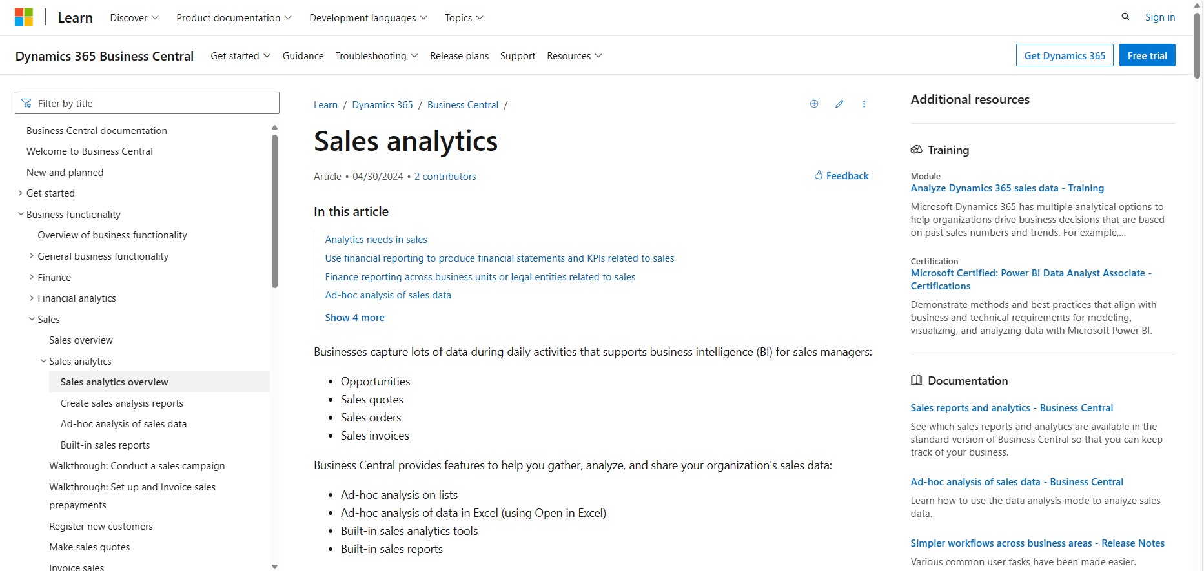
Analytics per functional area (finance, sales, purchase, inventory, …)
Notes:
This is the analytics story end-to-end for each functional area

Slide 7
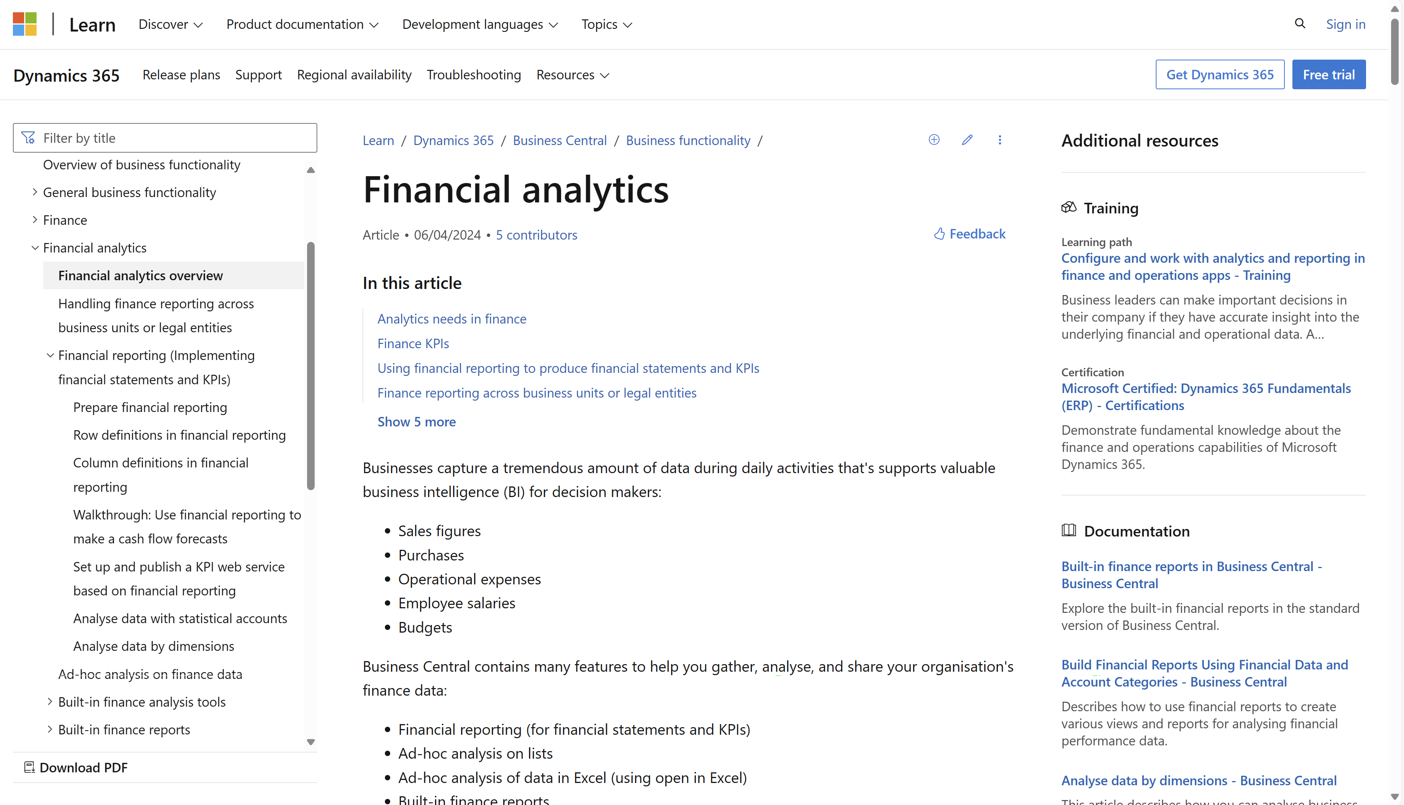
Financial Analytics (in docs)
Notes:
This is the analytics story end-to-end for each functional area

Slide 8
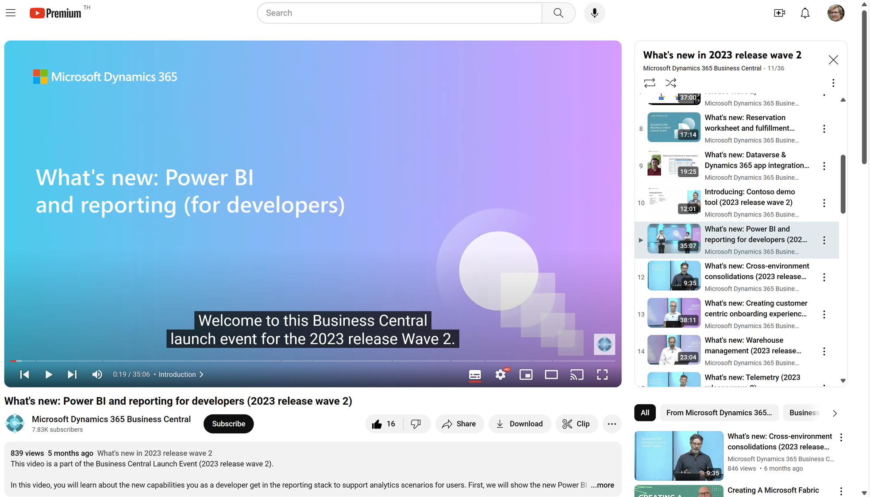
Watch the video to learn more…
Notes:
This video explains the BI triangle for developers

Slide 9
Watch the video to learn more…
Notes:
Power BI embed (for developers)

Slide 10
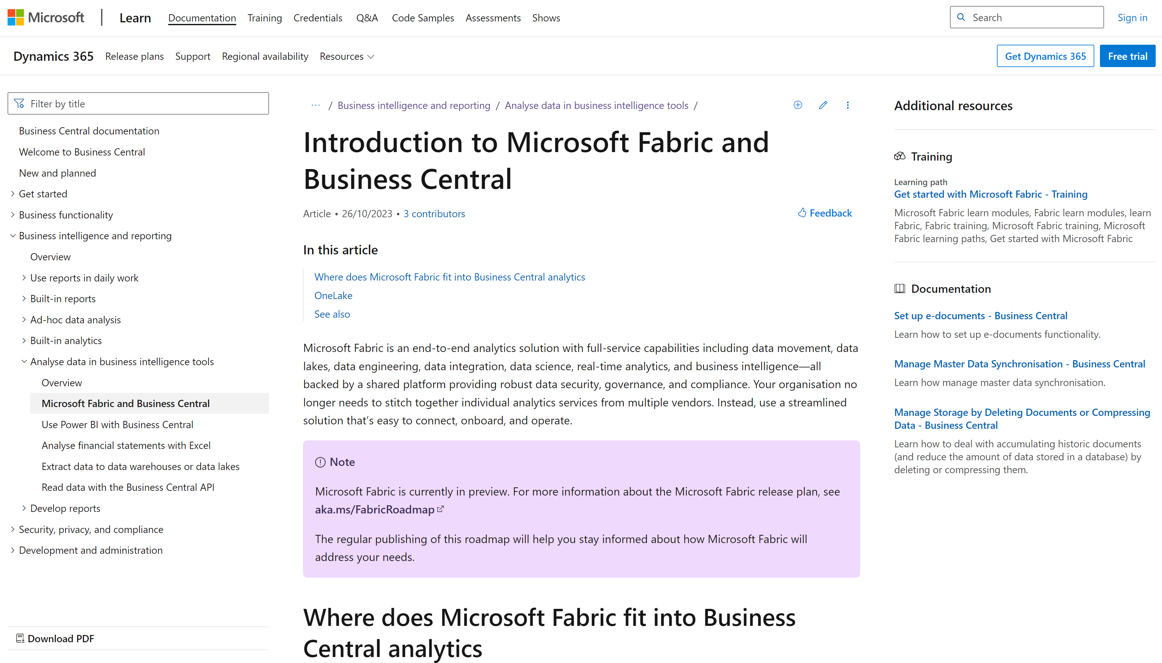
Notes:
If anyone asks about BC and Fabric

Slide 11
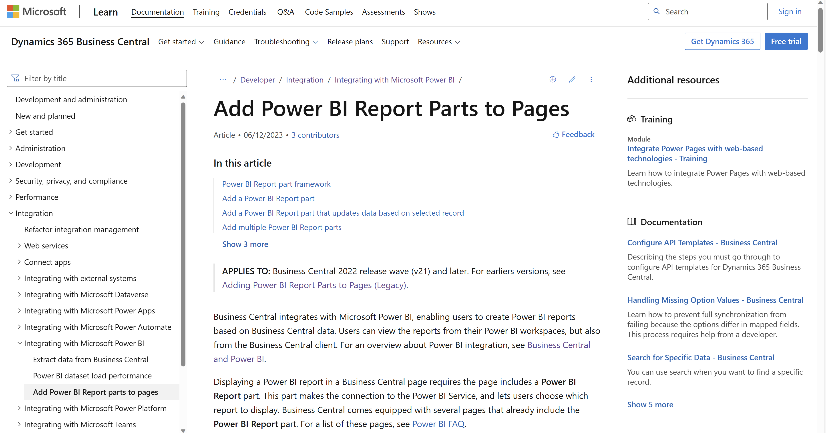
Notes:
Developer docs on how to embed Power BI on AL pages

Slide 12
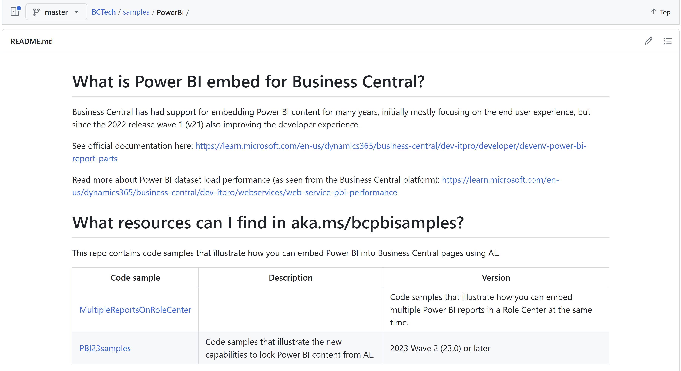
aka.ms/bcpbisamples
AL code samples for the new PBI embed capabilities in 2023w2
Notes:
Sample code on how to embed Power BI on AL pages

Slide 13
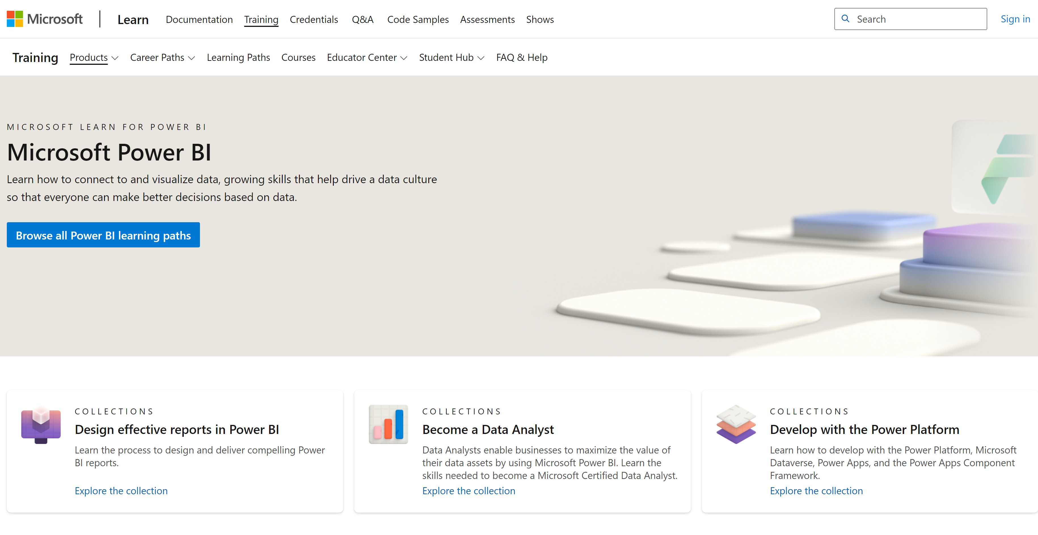
Notes:
PBI training

Slide 14
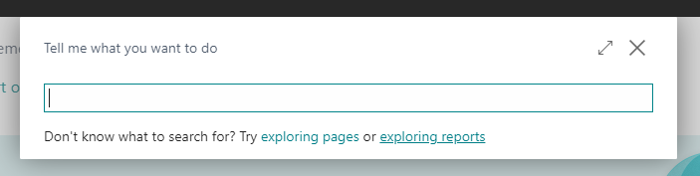
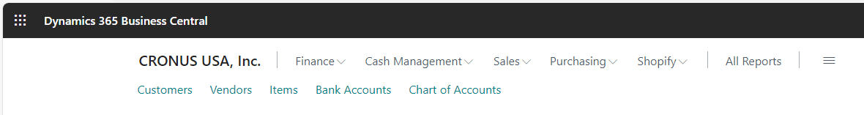
What are these new links???

Slide 15
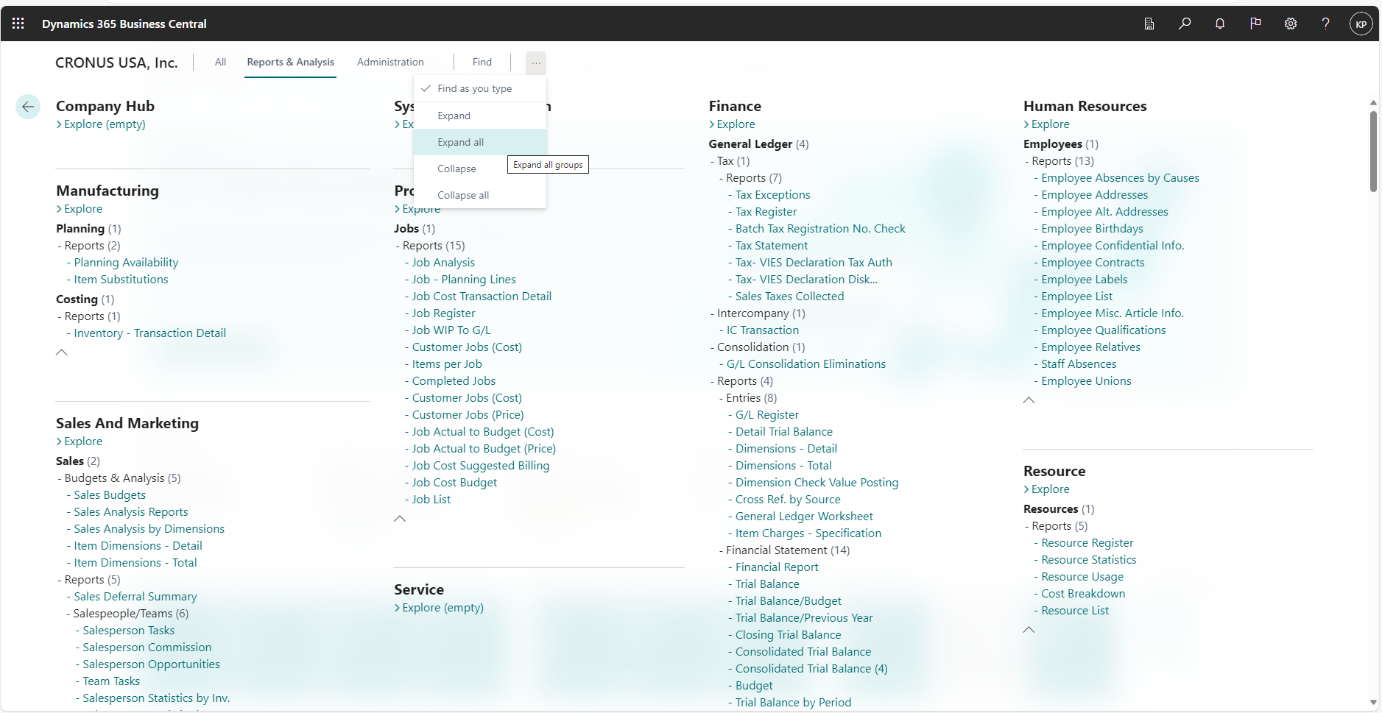
Report Explorer – shows all analytical capabilities
Notes:
If people ask if BC has any reports…

Slide 16
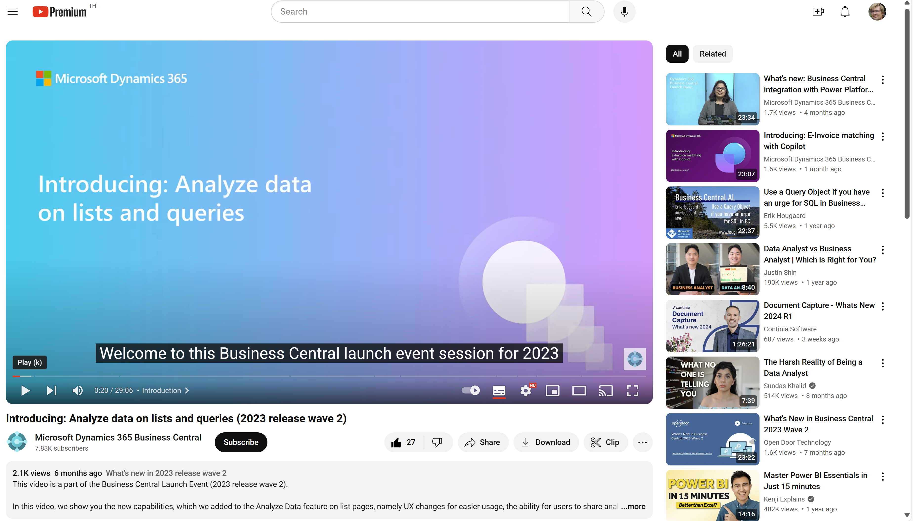
Watch the video to learn more…

Slide 17
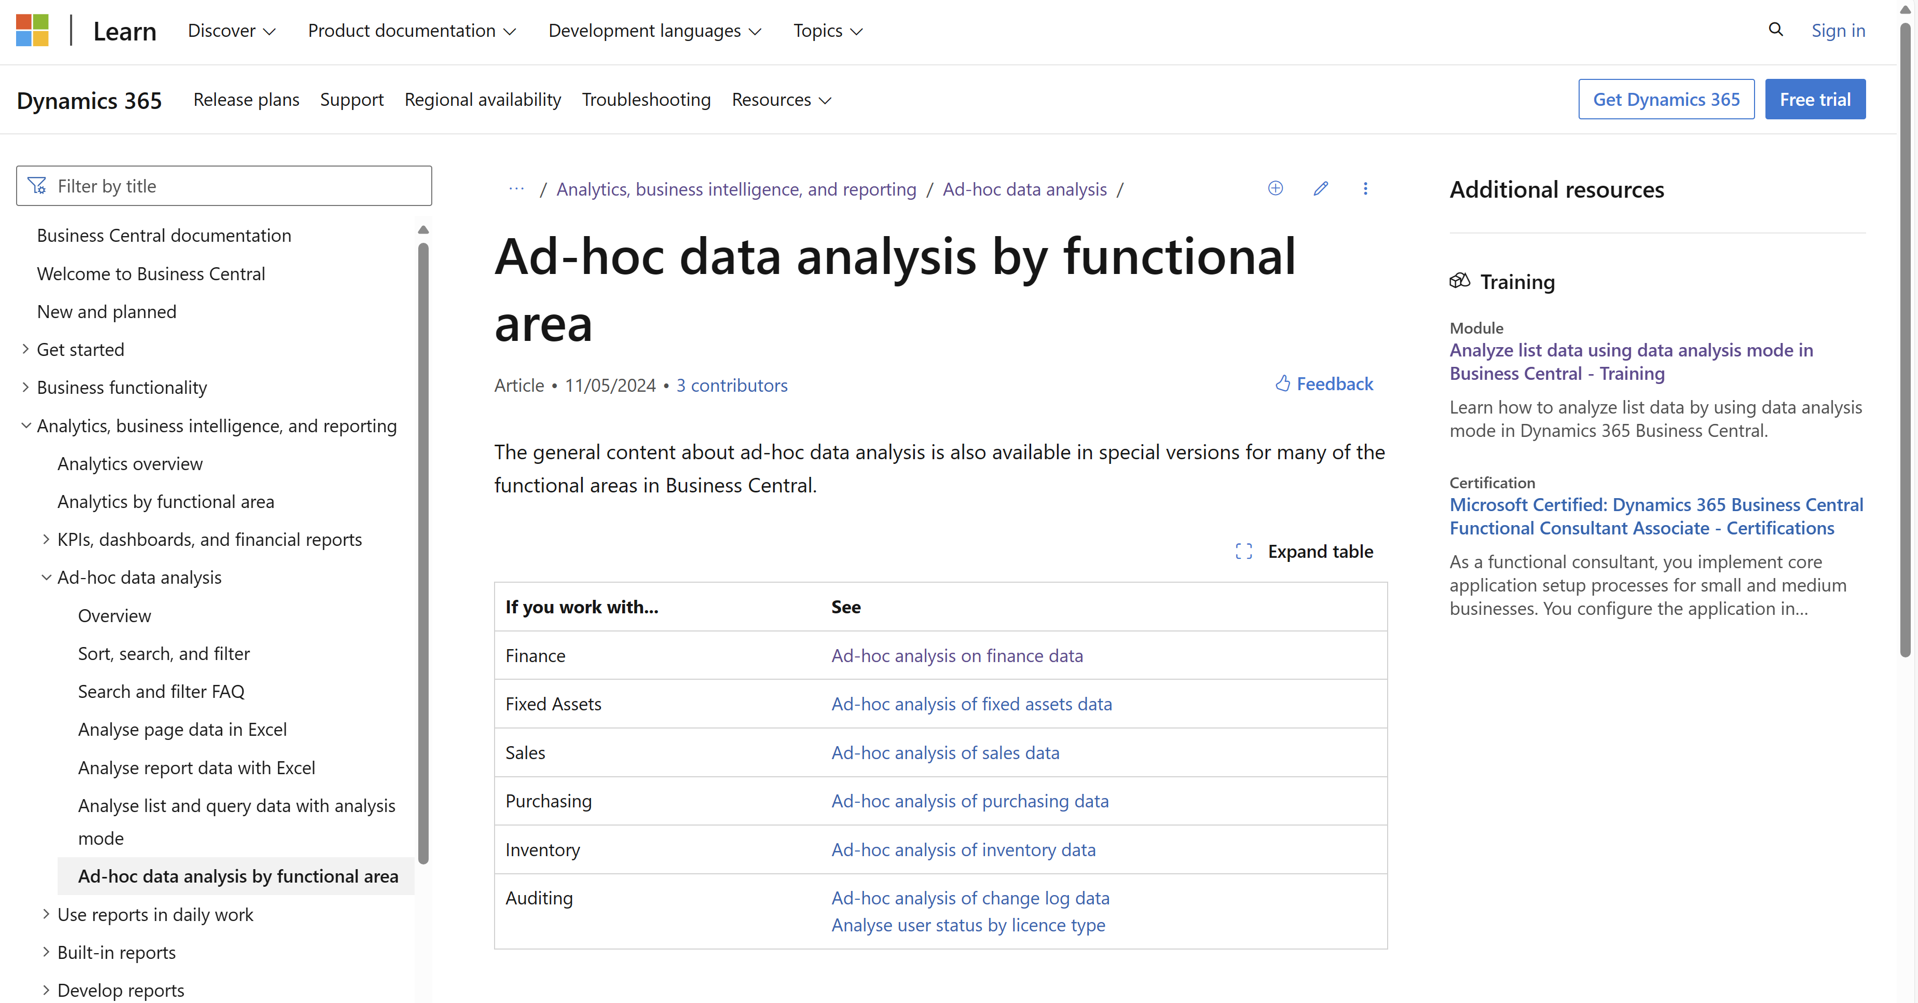
New documentation added (May 2024) aka.ms/bcReporting

Slide 18
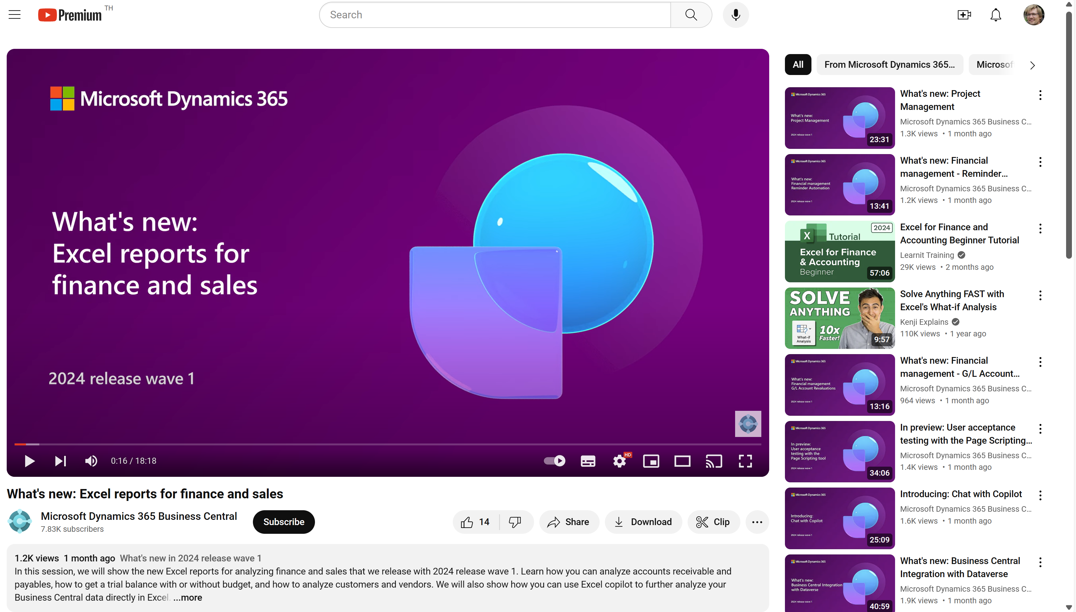
Watch the video to learn more…
Notes:
This video shows the new Excel reports that were shipped in 2024w1

Slide 19
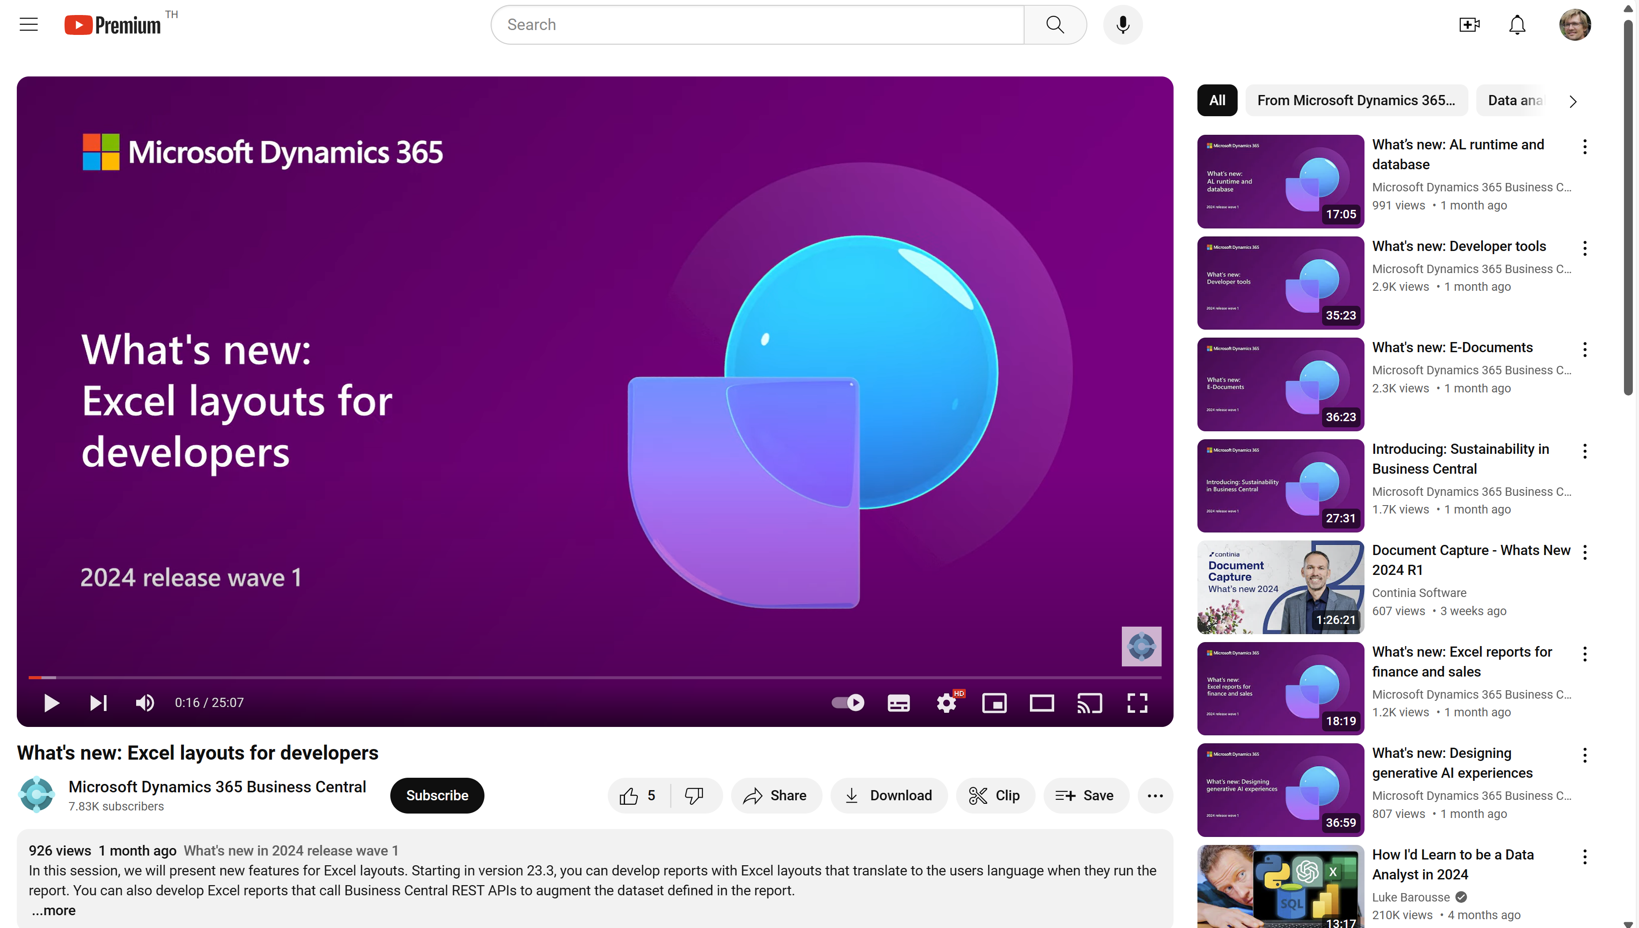
Watch the video to learn more…
Notes:
This video shows the new Excel layout features that were shipped in 2024w1

Slide 20
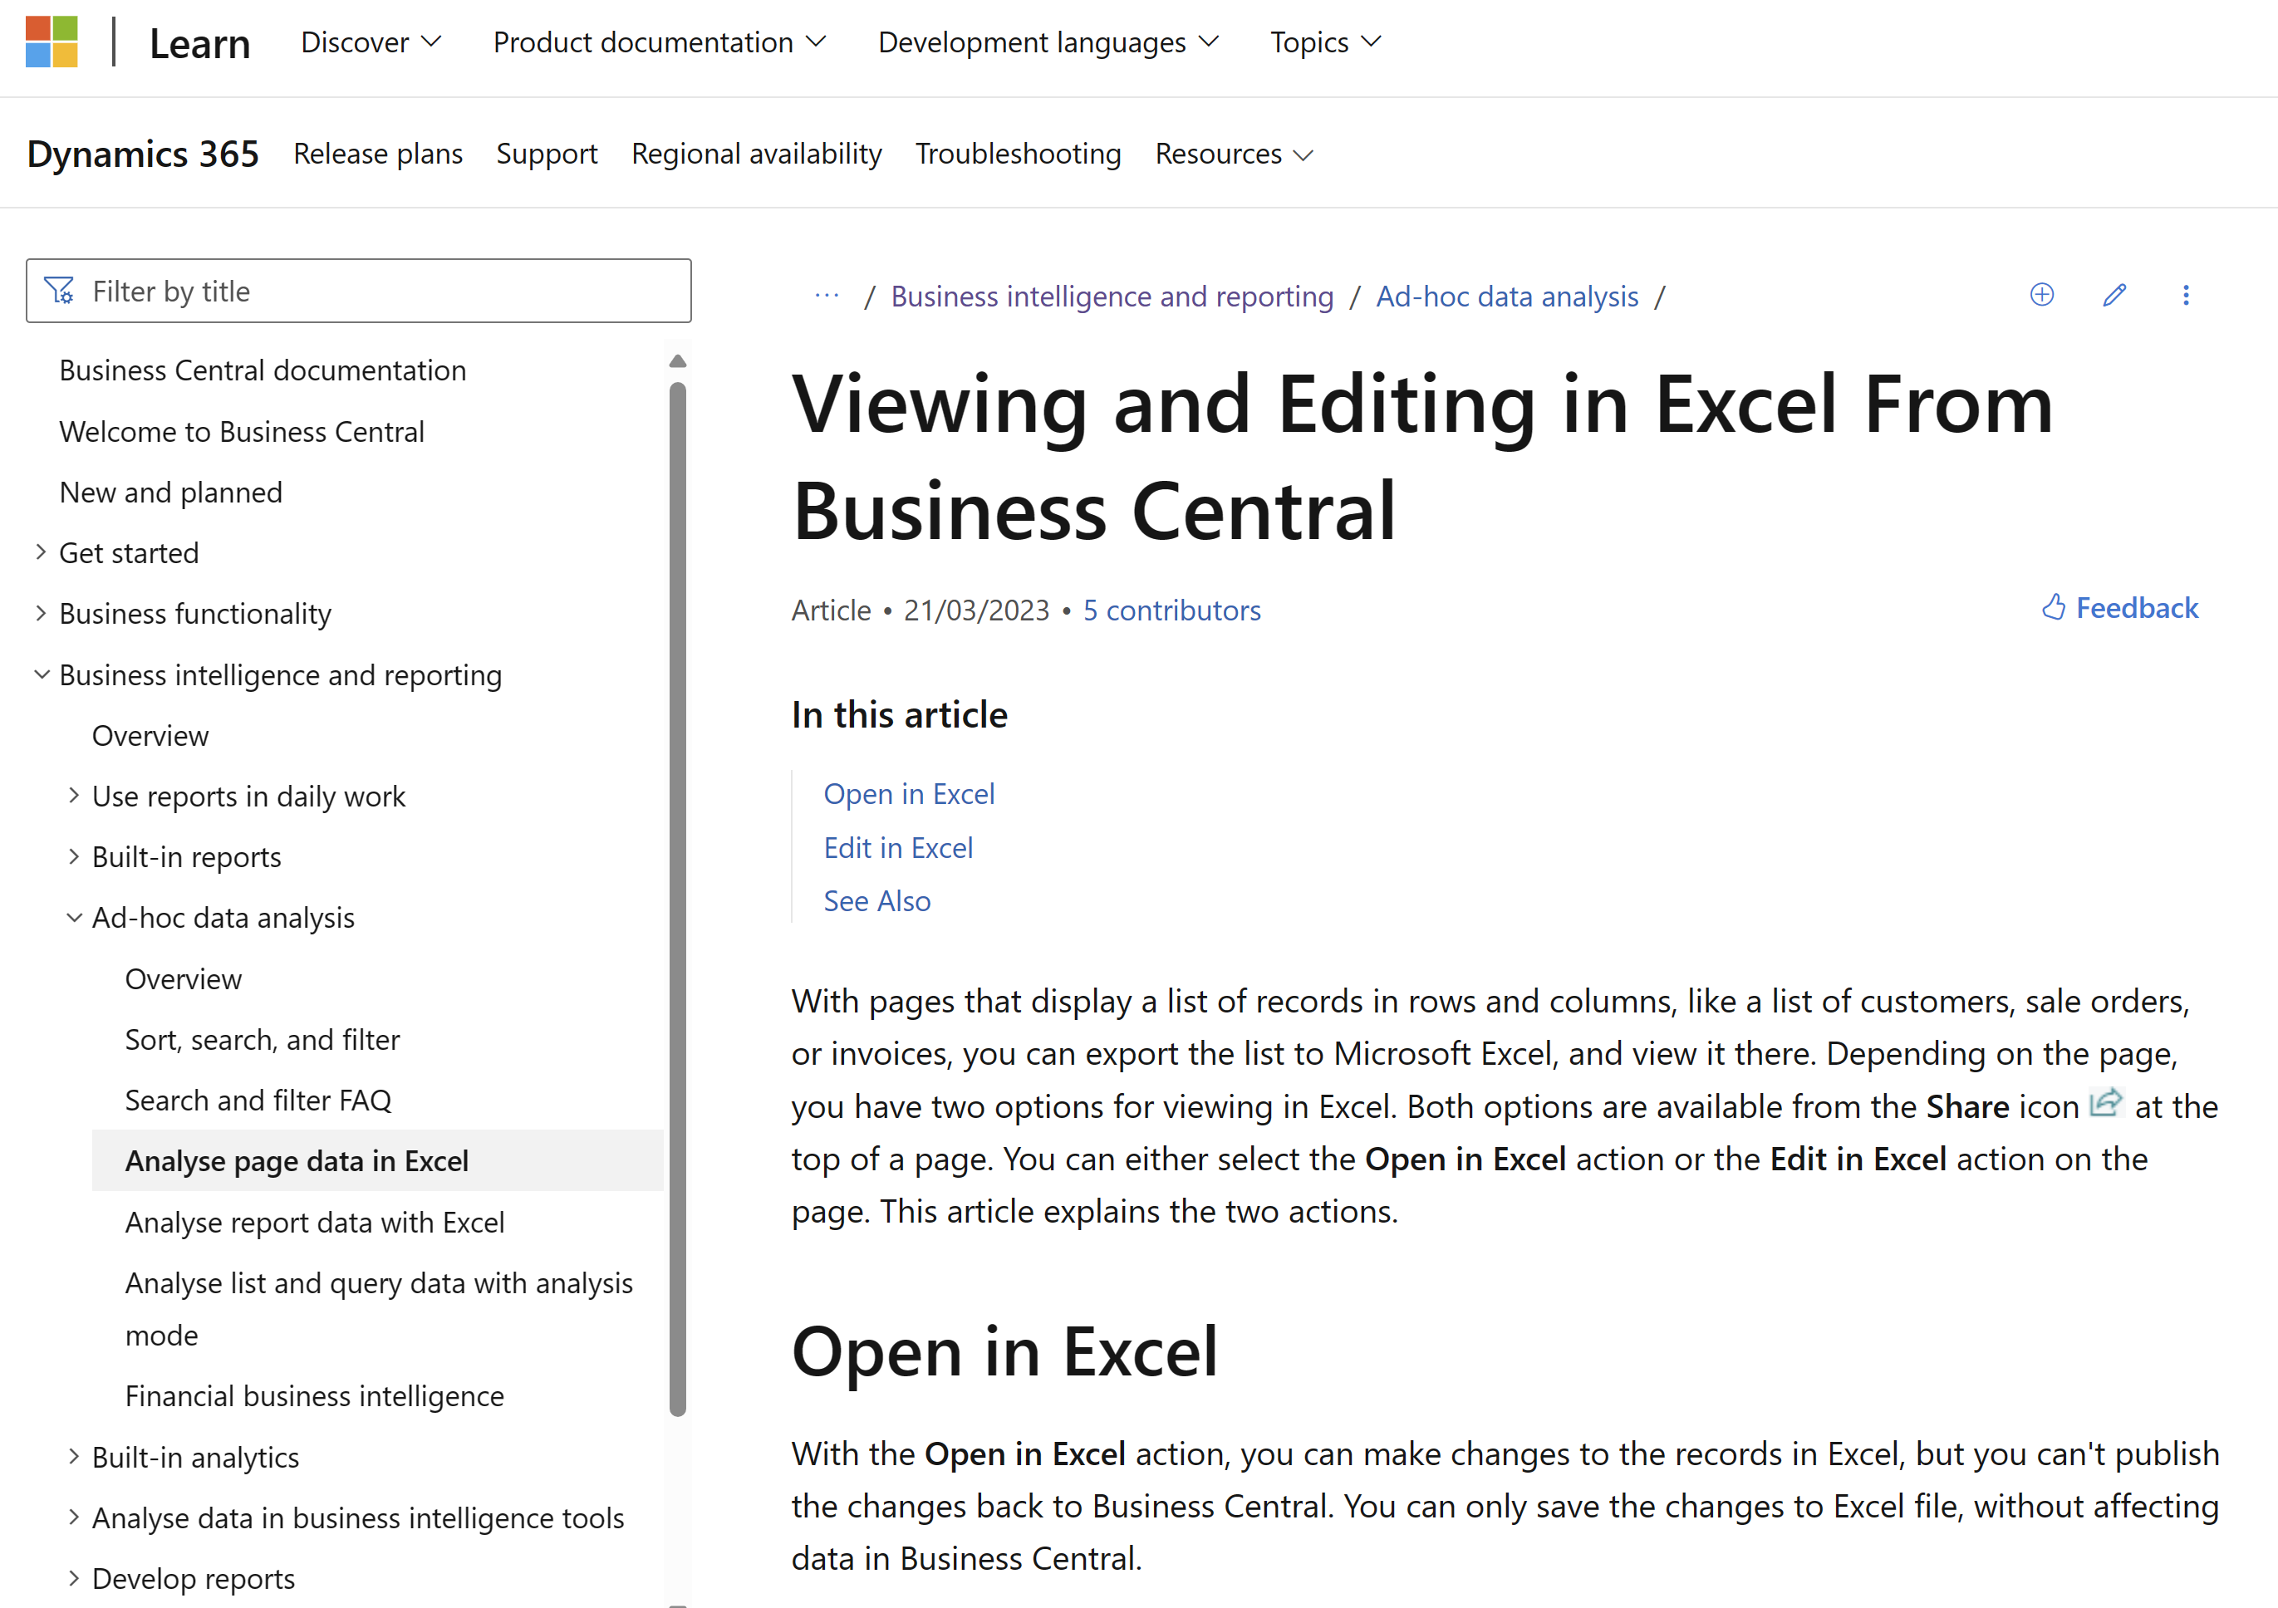
Want to learn more? aka.ms/bcReporting
Notes:
The section in user docs that explains how Excel fits into the analytics story (when consuming data)

Slide 21
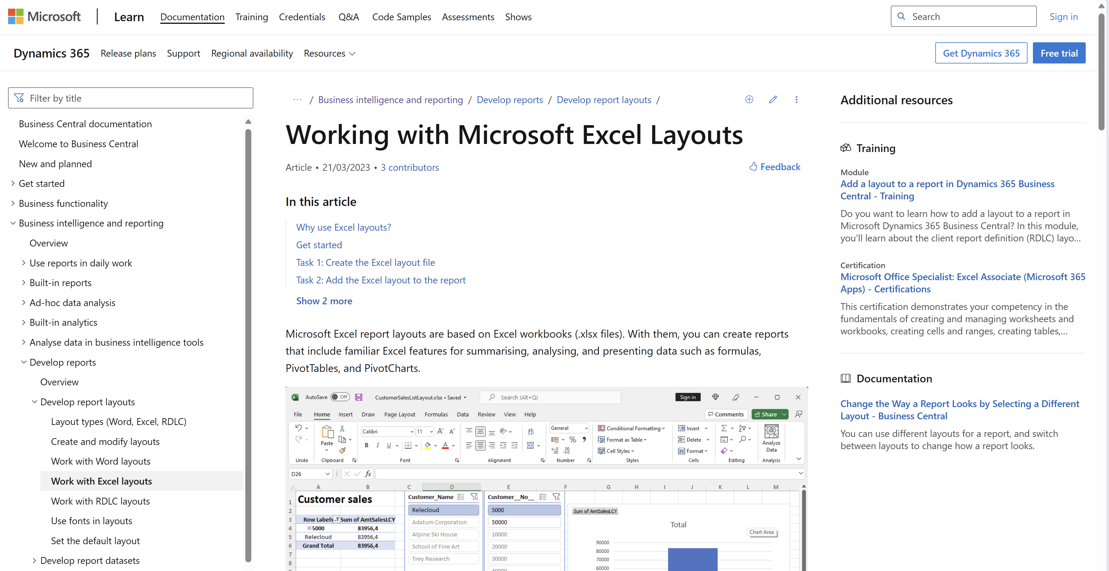
aka.ms/bcReporting
Notes:
The section in user docs that explains how Excel layouts work

Slide 22
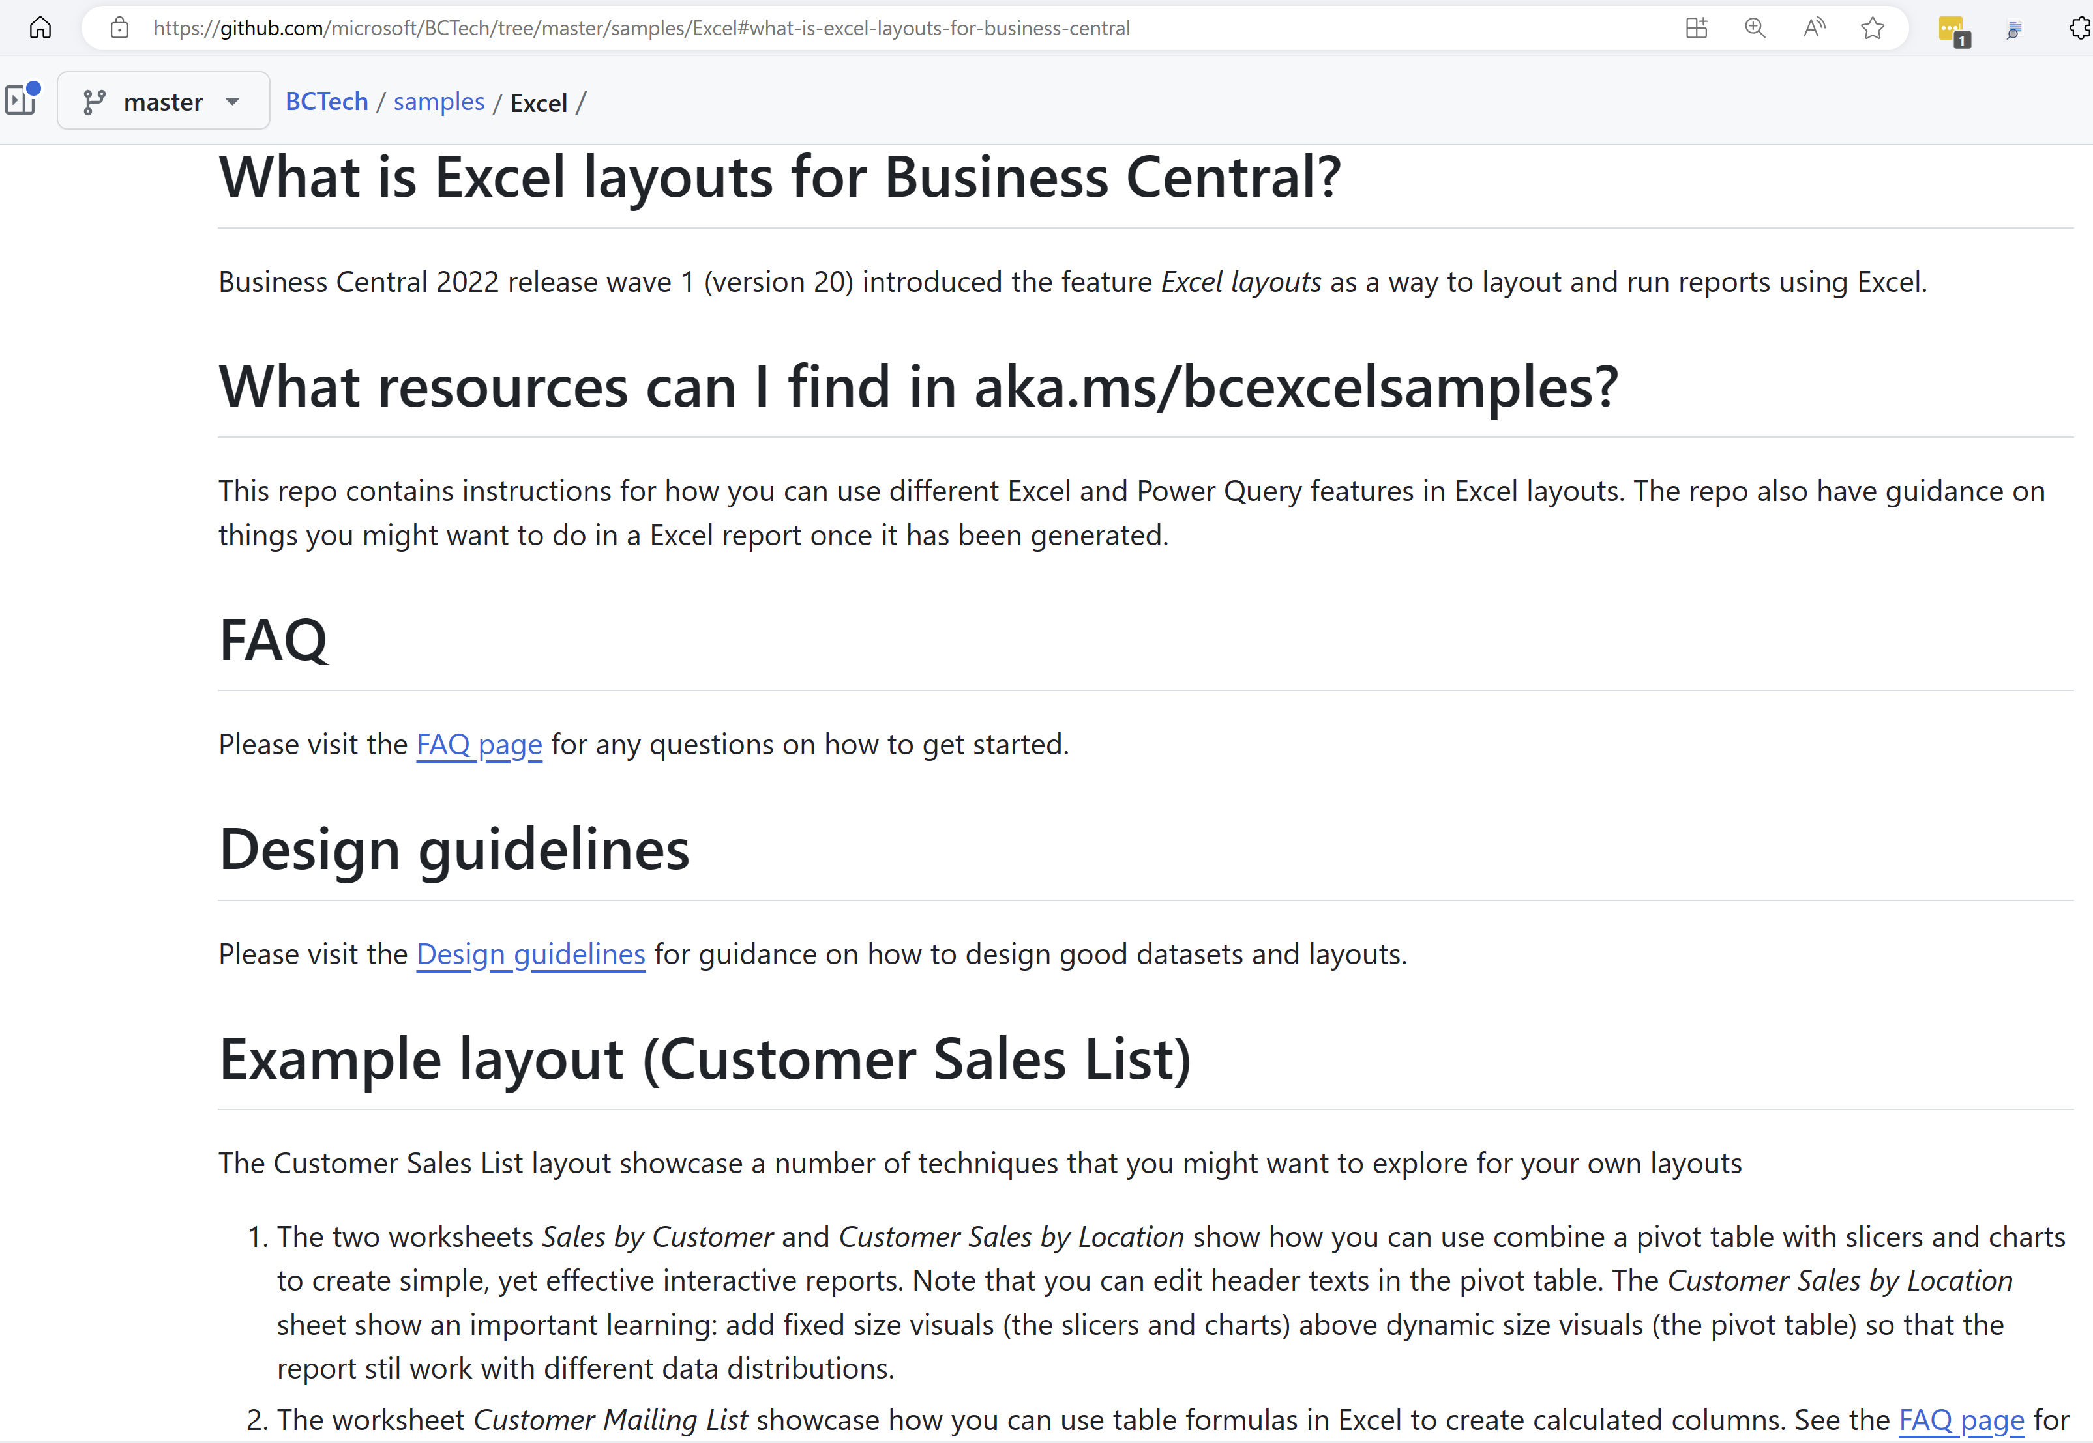
Want to learn through examples? aka.ms/ bcExcelSamples
Notes:
Sample code for learning different techniques. Work with existing reports

Slide 23
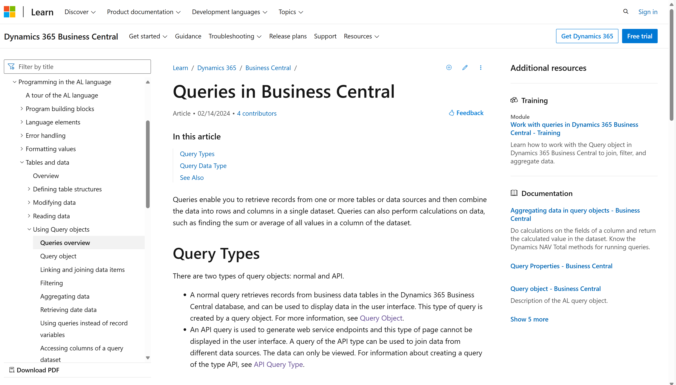
Want to learn more about AL queries?

Slide 24
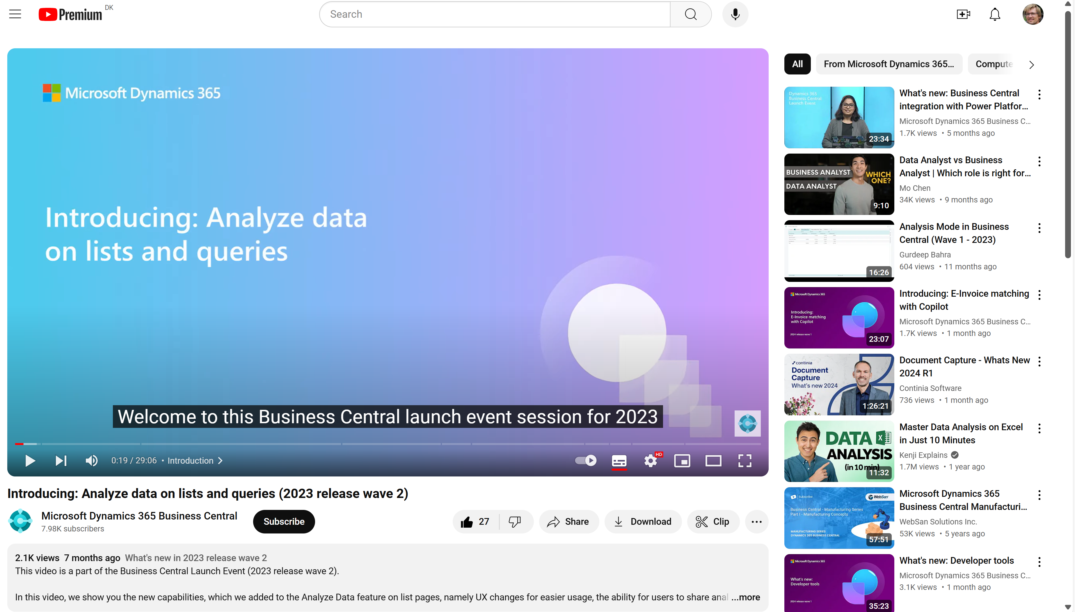
Watch the video to learn more…
Notes:
https://www.youtube.com/watch?v=qmLVKyHRhNc

